Slide 1
HACKOVERFLOW-2022
Consumer Analysis
- helping bussinesses to better analyze thier consumers
20bcse50- Kumar Jijnasu
20bcsb33- Jyotikrishna Behera
20bcsa46- Shakti Prasad Nanda

Slide 2
01
Problem statement
02
Solution - formulation
03
Technology stack
CONTENTS
04
Workflow
05
Final Application
06
Reference

Slide 3
PROBLEM STATEMENT
01

Slide 4
Helping business know thier customers better
For a Retailer company, knowing its Customers Loyalty is very important. The company must know when its customers are losing interest from them, so that they can get their presence back. The same thing we can incorporate in the small businesses and small retailers which usually lack in this tech support and advancement. Which will help them to scale up faster..

Slide 5
Solution
02

Slide 6

Solution
So, to solve the problem we will find the CLV (Customer Lifetime Value) for the businesses looking at its previous data and check if it is a high risk of losing the customer. And we will integrate this to an android app for making it more user friendly .

Slide 7

Technology stacks used ...
- Android Studio
- Flask API
- Postman
- Python
- K Means
- Py Charm IDE
-

Slide 8
Workflow
04

Slide 9
DATA PREPROCESSING
ANDRIOD APP FROM EMPTY BODY USING ANDRIOD STUDIO
CREATING FEATURES FOR RFM XGBOOST MODEL USING K-MEANS
USED SCROLL VIEW AND LINEAR LAYOUTS
XGBOOST MODEL (82% ACCURATE)
FINAL APP WITH 2 SCREENS
WEALTHY
BUSINESSMAN
HAPPY
COSTUMERS
☺
INTEGRATION USING FLASK API

Slide 10
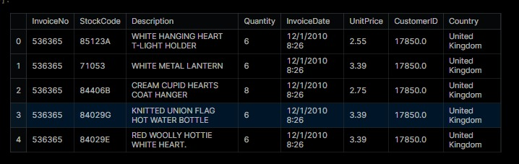
Solution approach and explanation
- To start of with the core of the project we made the model to analysize the consumers based on different aspects.
- Then we are integrating this models to the android app where the retailer or shopkeeper should enter the required information to and get the risk factor.

Slide 11
Final Application
05

Slide 12
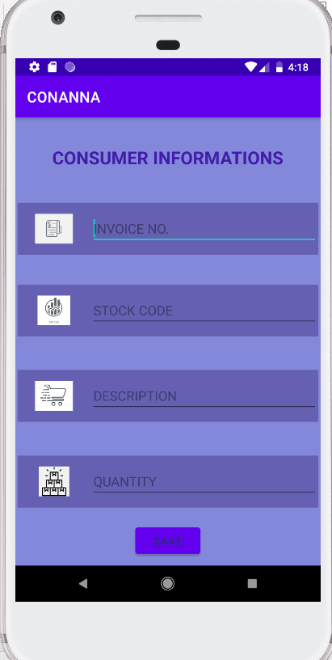
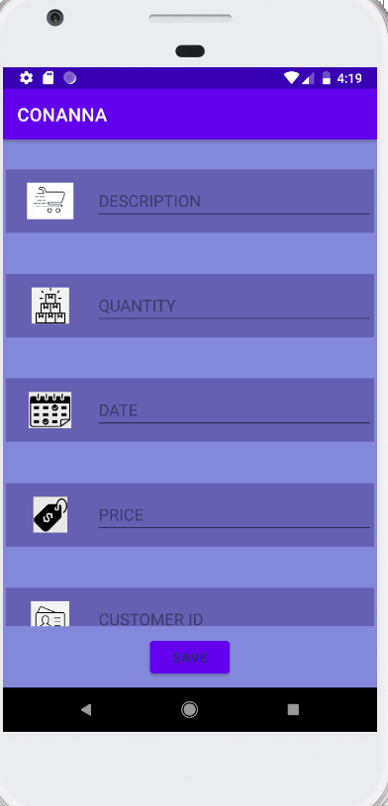
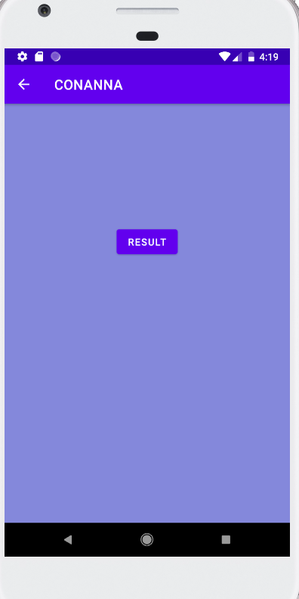

Slide 13
Conclusion and Future scope
So this project will empower the not only bigger players like flipkart, amazon, Walmart, etc. but also smaller businesses to boost their revenue and scale up their business. And in future we are trying to

Slide 14
References
06

Slide 15


Dependencies and reference
- Google, Coursera, Youtube

Slide 16
THANKS

